Slide 1
BLDC Velocity Control
William Kim

Slide 2
BLDC Velocity Control
Motivation: Why?
Brushed vs. Brushless DC
Control System: Block Diagram
Demonstration
  Proportional (P) Control
  Proportional-Integral (PI) Control
  Proportional-Integral-Derivative (PID) Control
Modeling: This is Tough!
Software Algorithm
LabView Control System Plots

Slide 3
Motivation (Why?)
To gain a better understanding of how to electronically commutate a BLDC motor with Hall Effect Sensor feedback.
To understand how to control (PID) a BLDC motor using a microcontroller.
To see the differences between P, PI, and PID control. Advantages and Disadvantages.
To learn and apply control systems theory.
  Modeling, Transfer Functions, Stability.
To learn LabView Control Design.

Slide 4
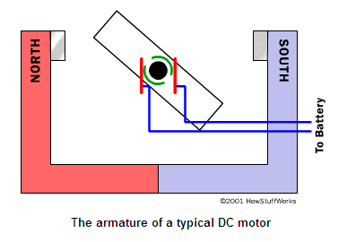
Brushed DC Motor
Permanent Magnets on Stator (outside)
The armature (electromagnet) rotates.
The electrodes attached to the electromagnet make contact with the “burshes” to the DC supply for rotation.

Slide 5
Brushed DC Disadvantages
Brushes eventually wear out.
  My gf had a broken blender.
Brushes make and break connection which causes sparks and electrical noise.
Brushes limit the maximum speed of the motor because of the friction.
Electromagnet in the center of the motor makes it harder to cool.

Slide 6
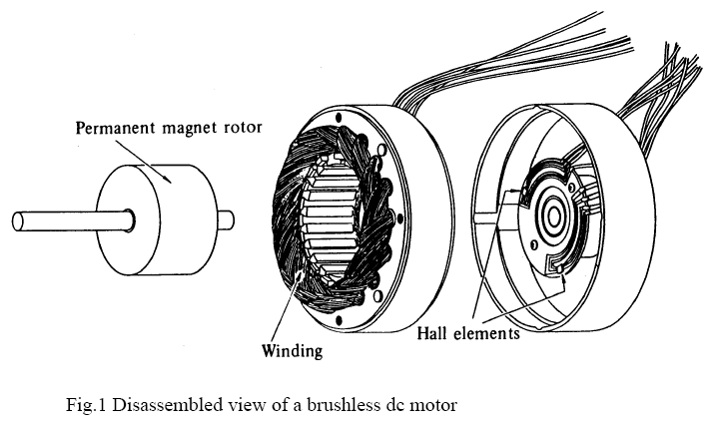
BLDC Motor
Permanent Magnets on Rotor (inside)
The electromagnets are on the stator (outside).
Electronic commutation with Hall Sensors.

Slide 7
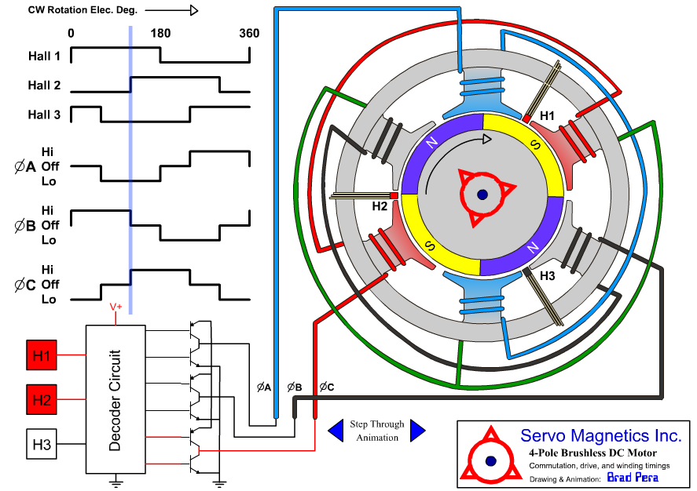
BLDC Motor

Slide 8
BLDC Motor advantages
No brushes that wear out.
No sparking and less electrical noise.
Easy to cool because the electromagnets are on the stator (outside).
You can have a lot of electromagnets on the stator for more precise control.

Slide 9
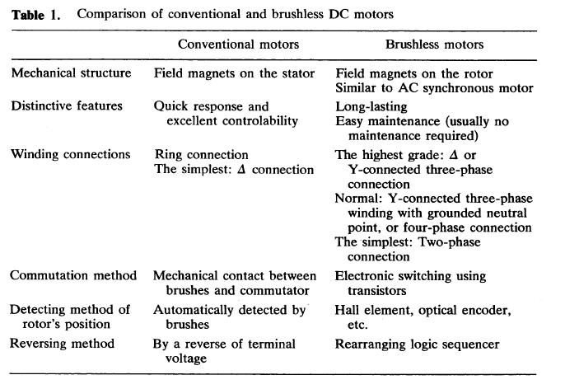
Brushed vs BLDC Motor

Slide 10
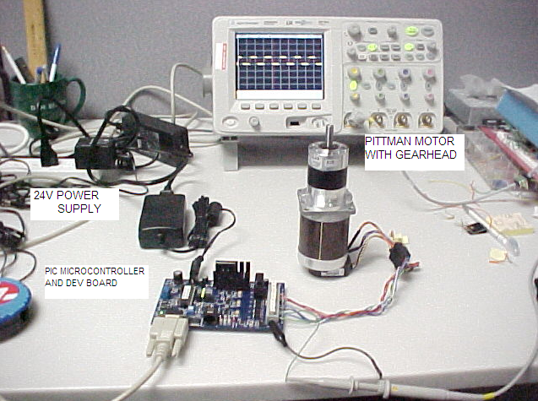
Control System

Slide 11
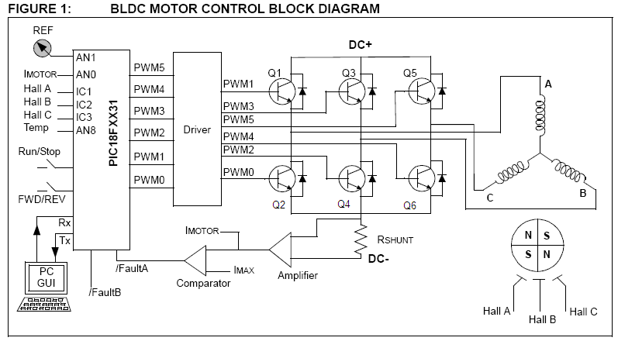
Block Diagram

Slide 12
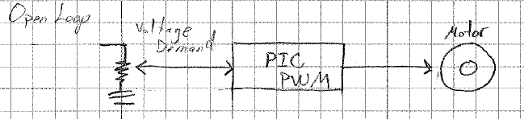
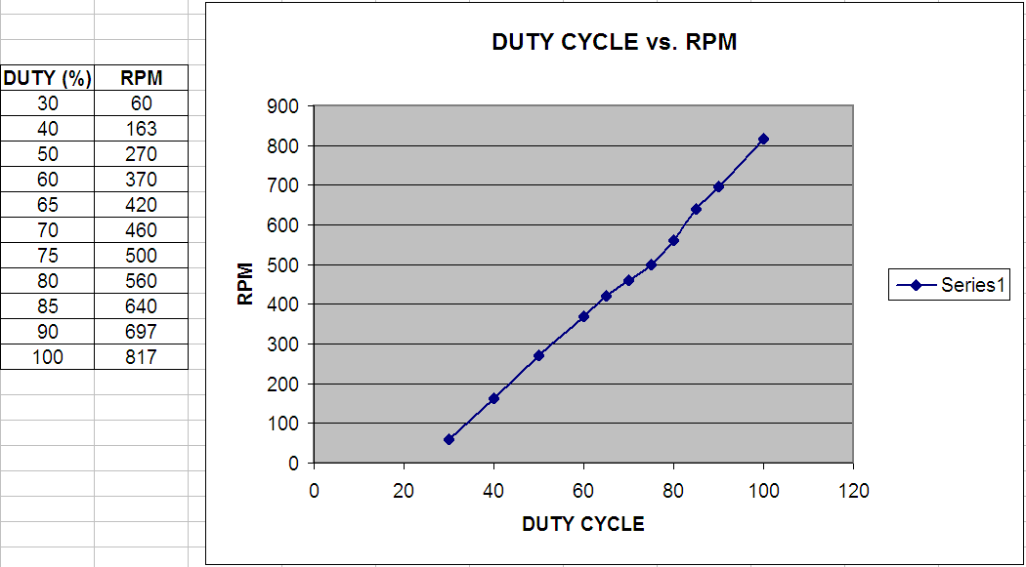
Open Loop Control

Slide 13
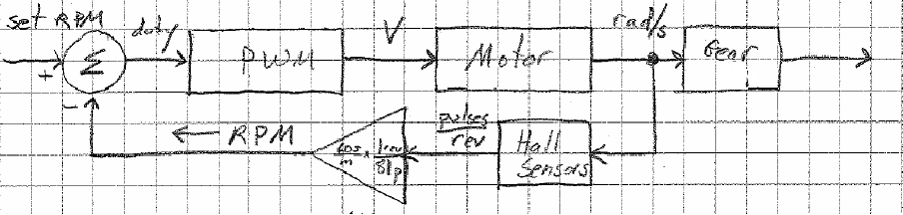
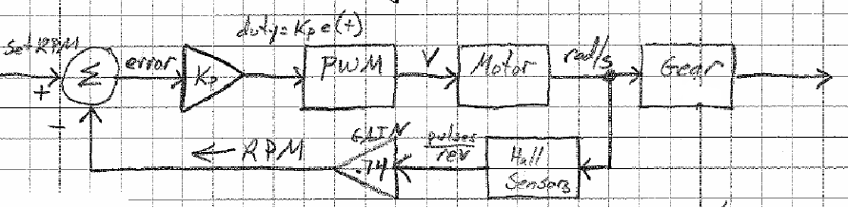
Closed Loop Control
Proportional Gain (KP) added
Speed error is fed into the compensator to adjust the PWM duty cycle to maintain speed.

Slide 14
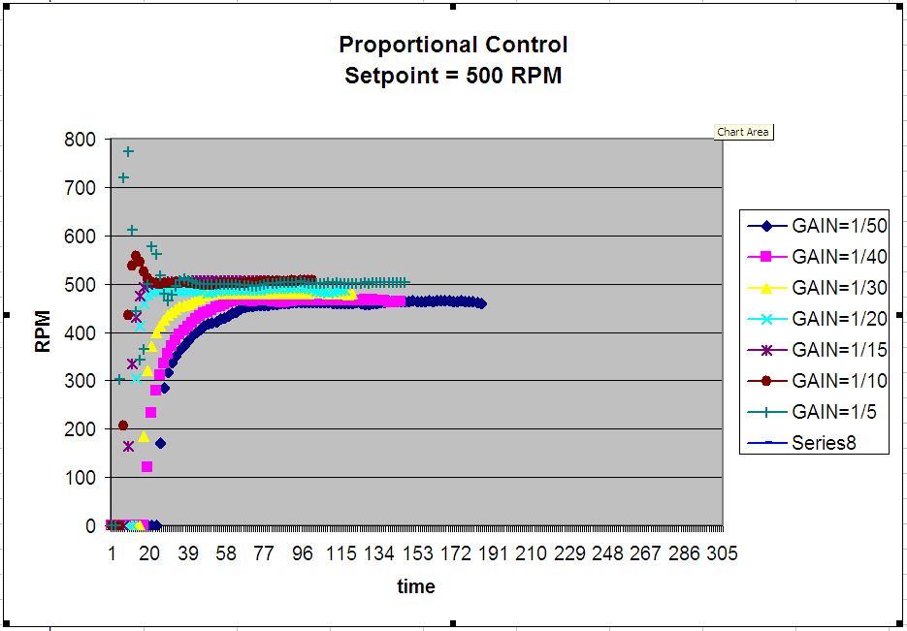
Proportional (P) Control
Note: Increasing gain reduces Steady State Error.

Slide 15
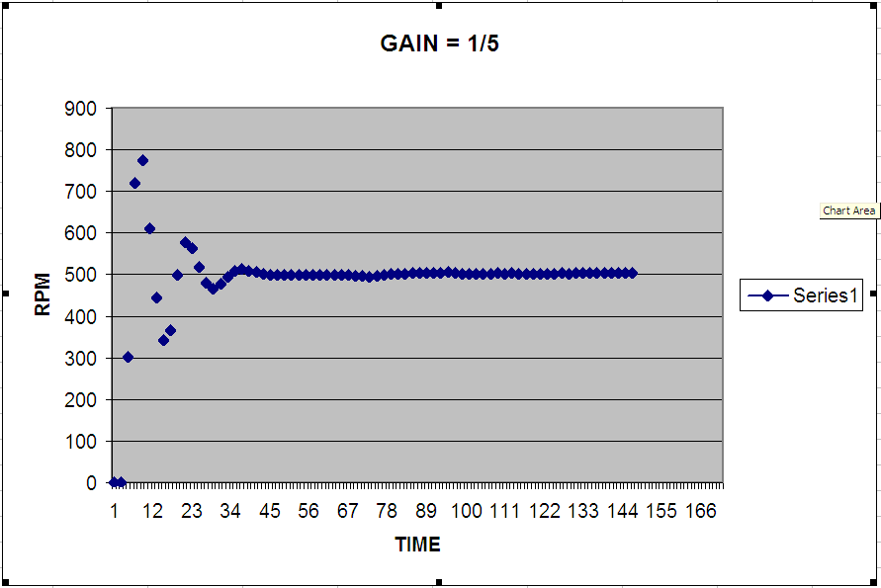
Proportional (P) Control
Note: High gain causes overshoot (oscillations)

Slide 16
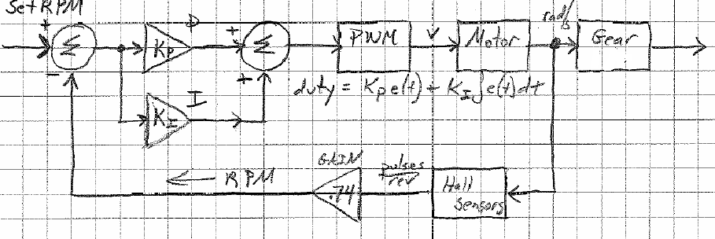
Proportional-Integral (PI)
Block Diagram

Slide 17
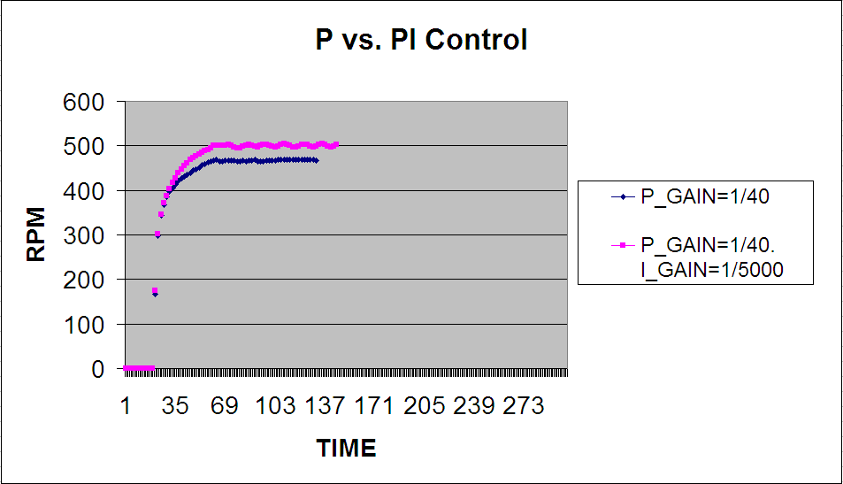
Proportional-Integral (PI) Control
Note: Adding the Integral term minimizes/eliminates Steady State Error.

Slide 18
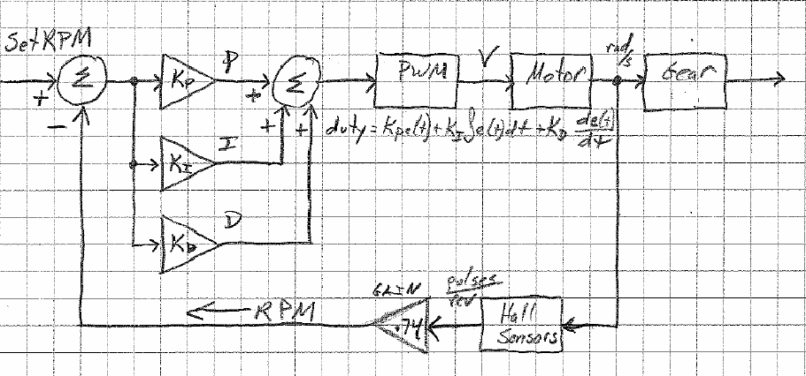
Proportional-Integral-Derivative (PID) Block Diagram

Slide 19
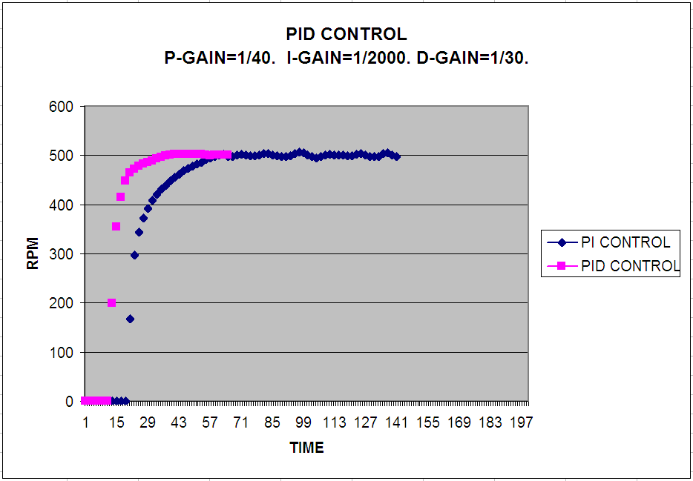
Proportional-Integral-Derivative (PID)
Note: Adding Derivative term improves the transient (time) response.

Slide 20
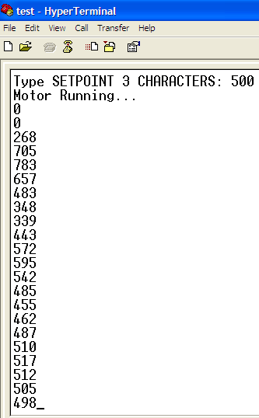
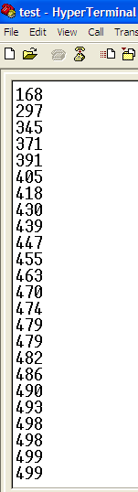
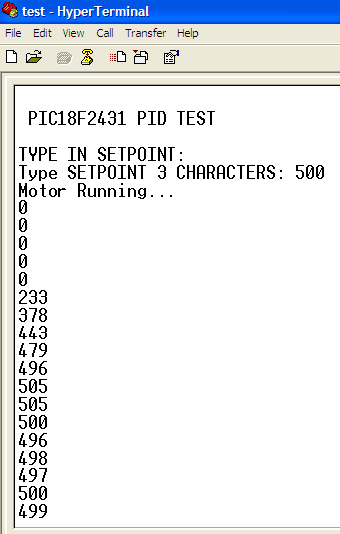
RPM Output

Slide 21
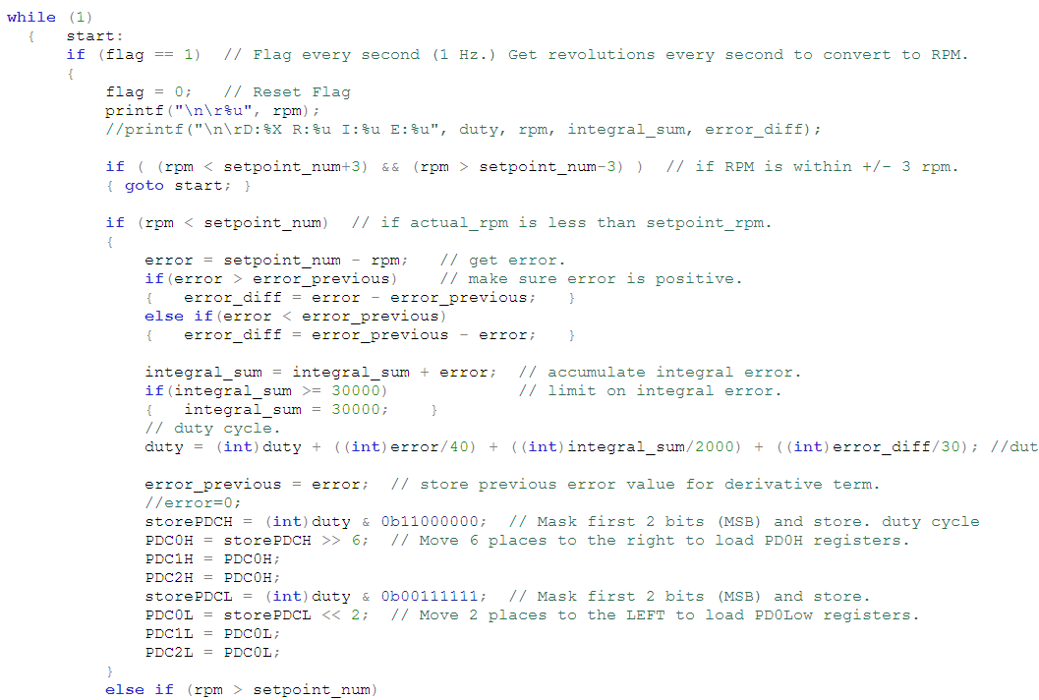
Software Algorithm

Slide 22
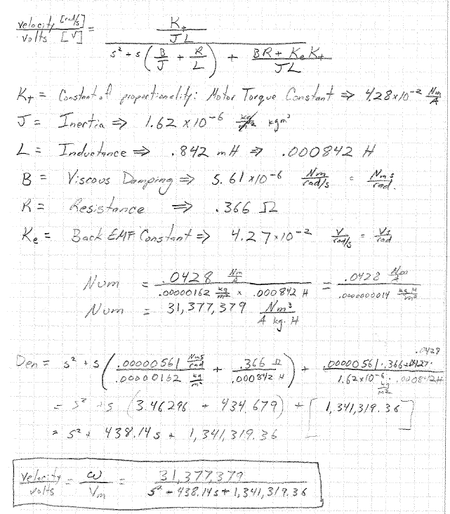
Modeling: Transfer Function

Slide 23
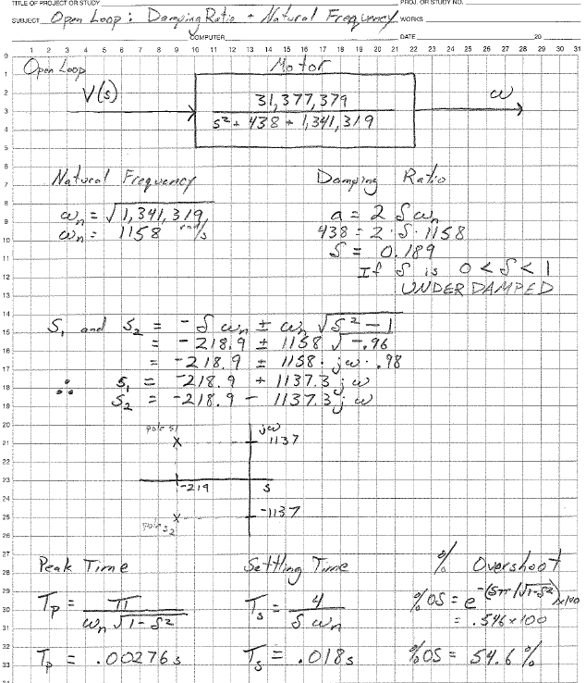
Modeling: Open Loop Analysis

Slide 24
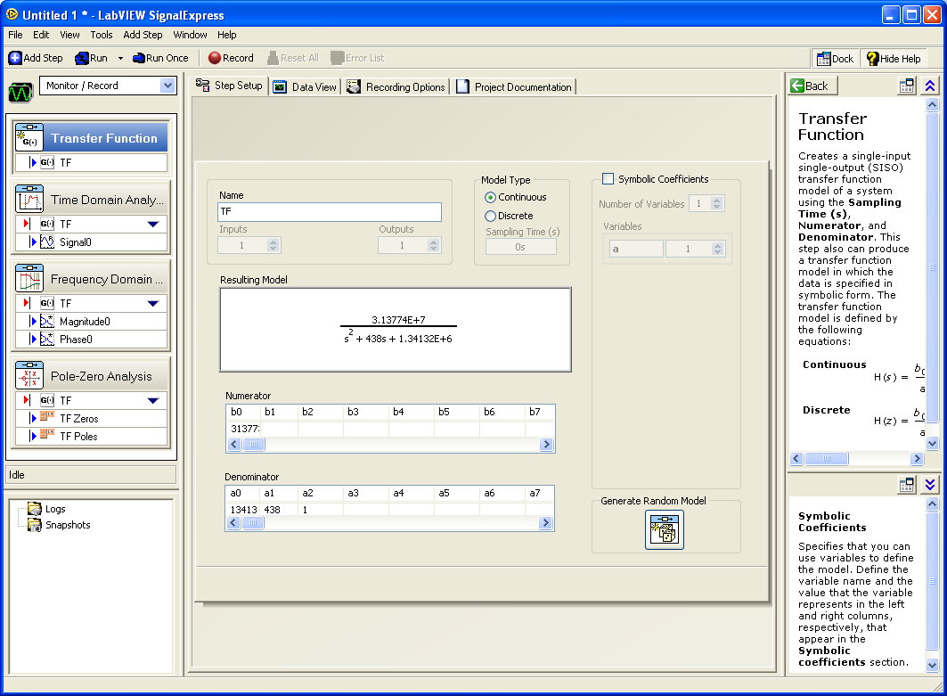
LabView Control Design Assistant

Slide 25
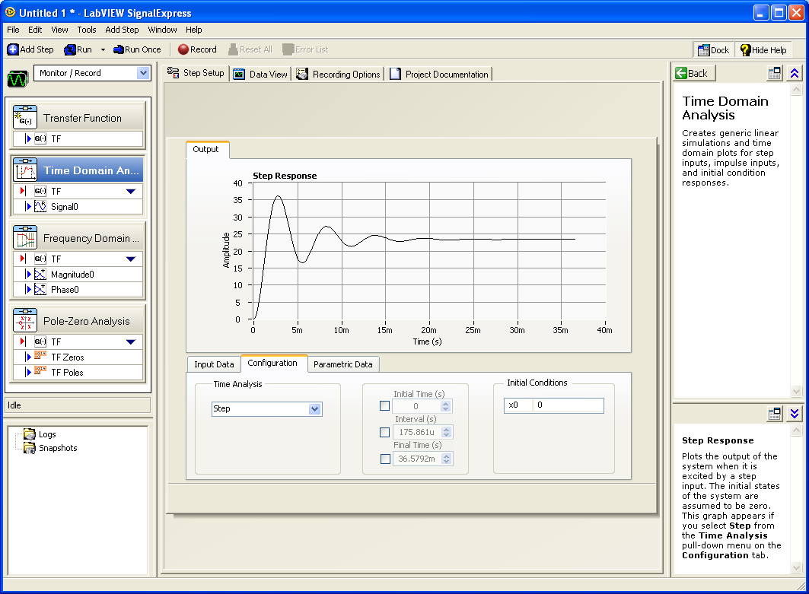
Step Response

Slide 26
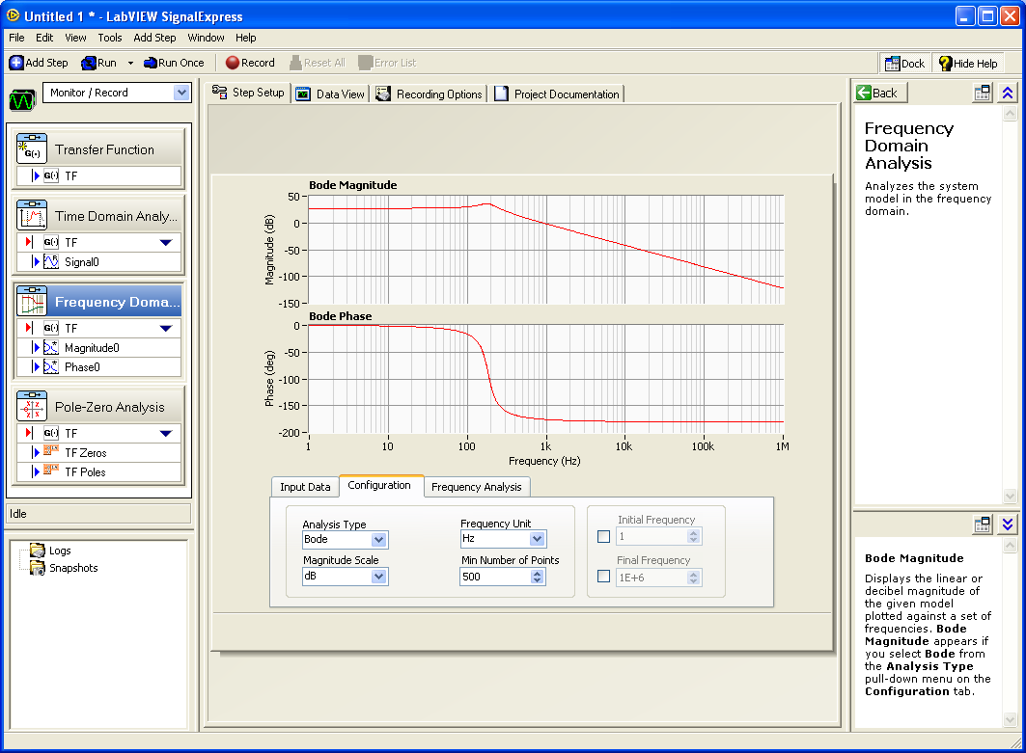
Bode Plots: Magnitude & Phase

Slide 27
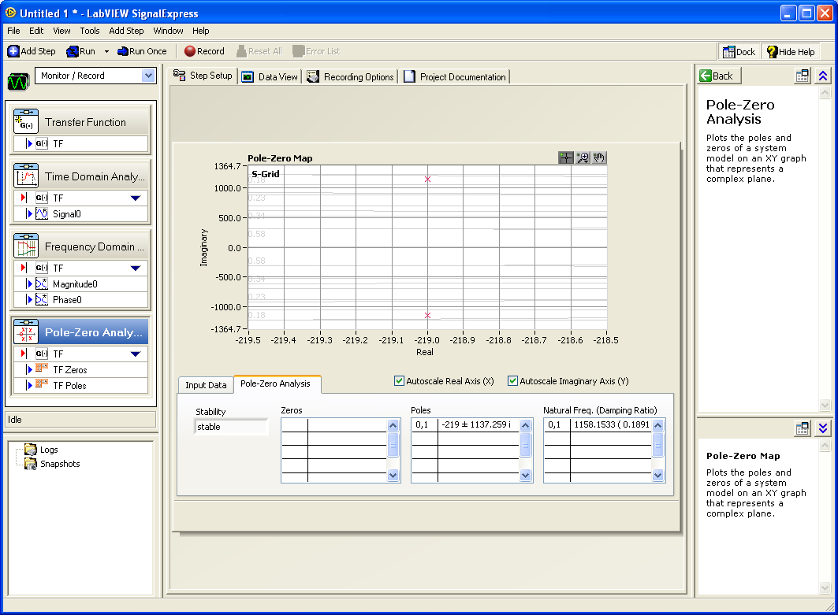
Pole-Zero Analysis

Slide 28
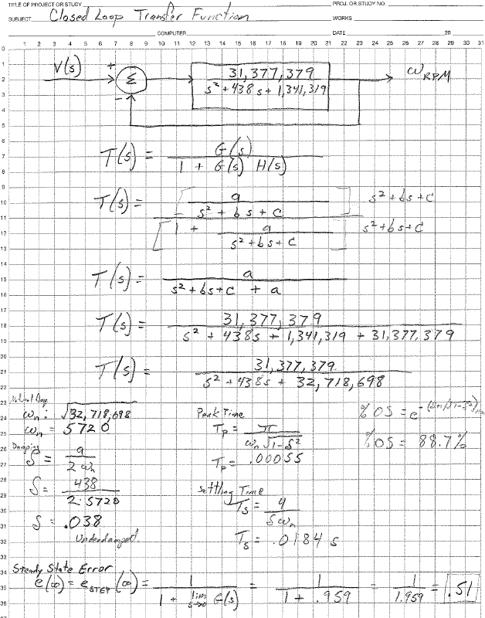
Modeling: Closed Loop Analysis

Slide 29
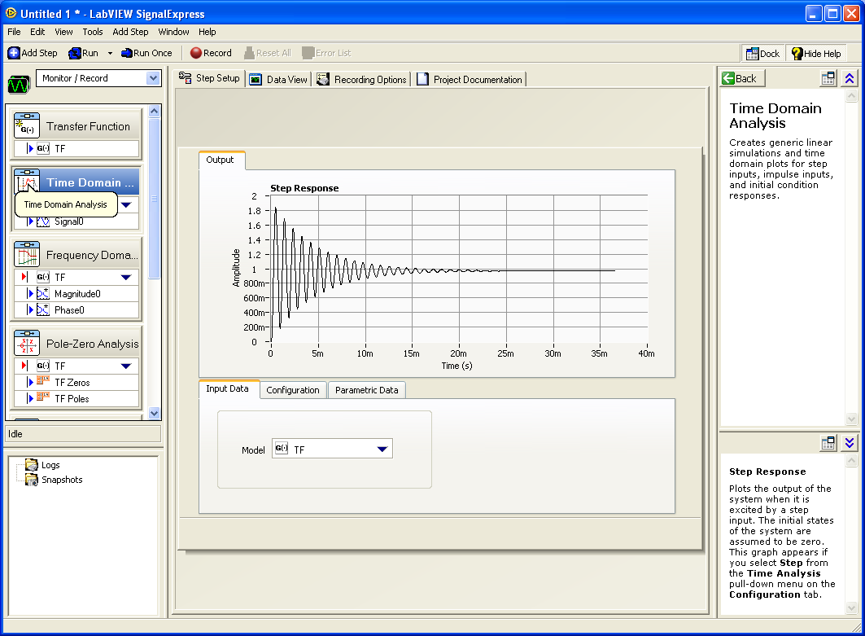
Closed Loop Step Response

Slide 30
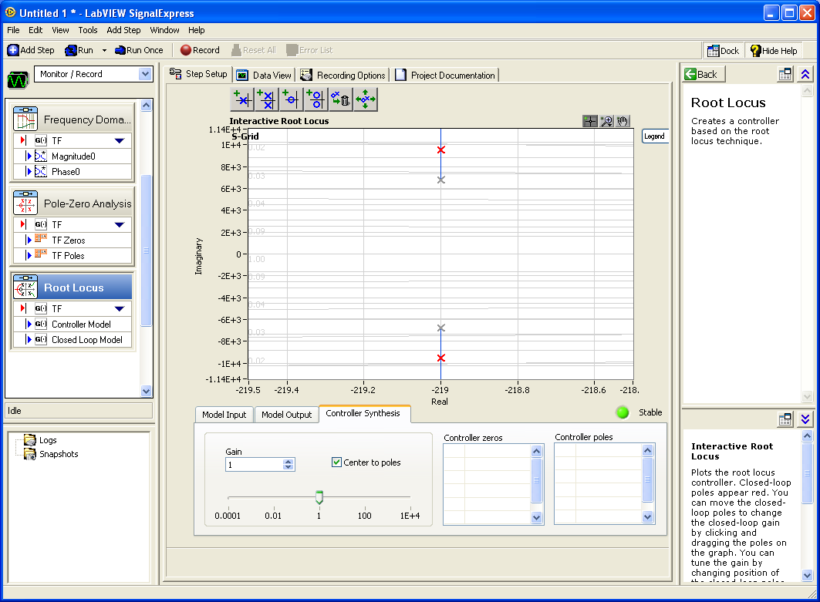
Root Locus Plot
Definition: Location and direction of the roots of a system as the gain is changed.

Slide 31
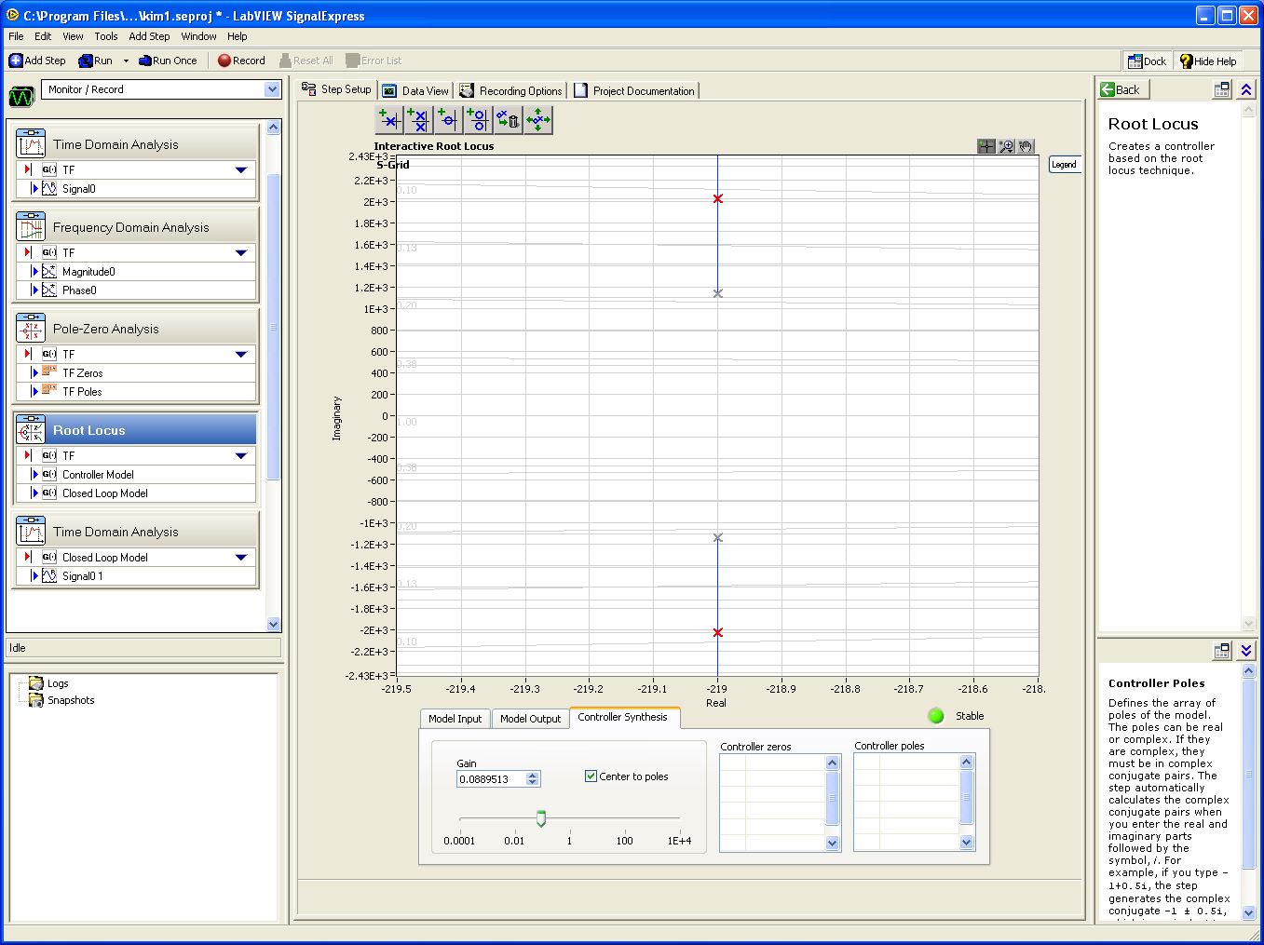
Root Locus Plot: Gain Change

Slide 32
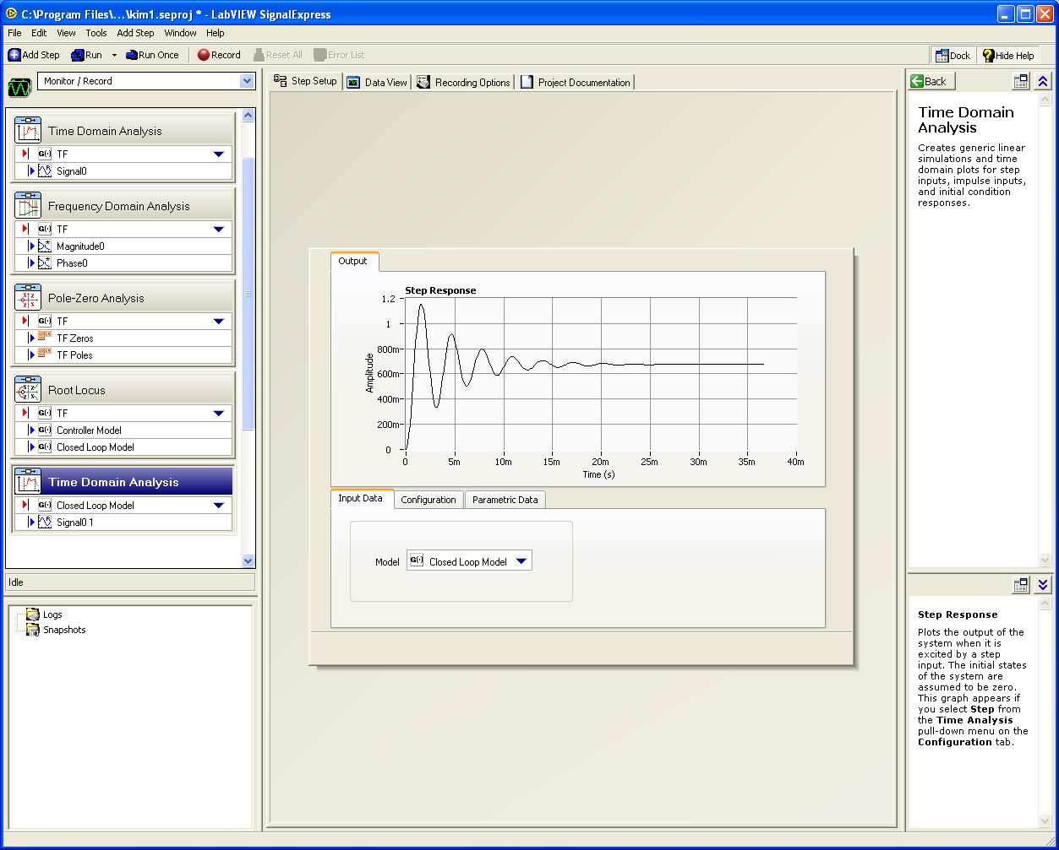
Lower Gain

Slide 33
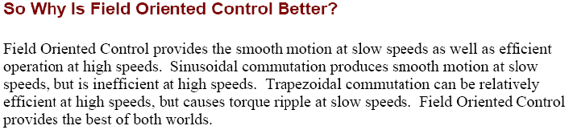
Future Work
Continue Analysis: Modeling, State Space Math, Root Locus, & Nyquist Analysis.
  I want to see the math justify my system.
Simulations: in Matlab and/or LabView
Control with Loads: Velocity, Position, Torque
Look Into:
  Sinusoidal Commutation vs. FOC:
    Brushless AC Motor Control.
    AC Induction Motor Control.

Slide 34
Conclusions
P Control: The higher the gain, the smaller the steady-state error, but the larger the percent overshoot.
PI Control: Eliminates steady-state error.
PID Control: improves transient response and steady state error.

